Slide 1
L2d2
Cu boulder
Csci 3155: principles of programming languages
Summer 2018
Spencer wilson
6/12

Slide 2
PLAN
Q&A before class assignment
Ambiguous Grammars
In class exercise
Understanding JavaScripty

Slide 3
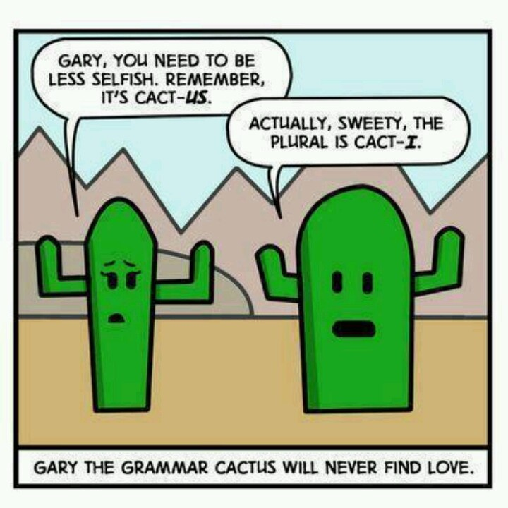

Slide 4
Coding in Class
Today we will be doing a coding exercise. Please go to Moodle and download todays inclass file.
Folder of Importance/Additional Code Samples/Lab2/L2D2_inClass.js
This is a javascript file. Try running it from the terminal with the nodejs interpreter.
node <file_path>/L2D2_inClass.js

Slide 5
ANNOUNCEMENTS
University Deadlines :
http://www.colorado.edu/summer/calendars/session-d
Tomorrow – Last day to drop no W grade recorded or tuition assessed
I would like for all of you to stay in the class but it is up to YOU!
Lab 1 master Moodle quiz released – it’s not for a grade
Lab 2 autograder is live. Please be sure that you log in with the correct info. (I’ll put a note to piazza about this)

Slide 6
Announcements
Lab 1 “quiz”, the in class quiz from Monday is not “due” ever. But if you want to go over solutions let me know.
Feel free to post and collectively create a solution set on Piazza.
As incorrect answers arise, attempt to articulate why the answer is incorrect (that’s super helpful in learning)

Slide 7
Questions?
?
Before class assignment

Slide 8
Grammars

Slide 9
terminology
Meta symbols
Terminals
Non-terminals
Production
Language
Alphabet
… so many more terms….

Slide 10
Warming up
Does ‘01’ exist in the language defined by this grammar ?
What about ’0101’?
And ‘010101’?
S ::= 0S1 | SS | ϵ

Slide 11
Brain Teaser – Grammar
Is this grammar ambiguous? If so demonstrate it by creating 2 parse trees for the same sentence that exists in the language defined by the grammar
S ::= A | B
A ::= 0S | ϵ
B ::= S1 | ϵ

Slide 12
Questions?
?
Grammars

Slide 13
In class exercise

Slide 14
Questions?
?
In Class Exercise

Slide 15
Understanding Javascripty

Slide 16
Coding in Class
Today we will be doing a coding exercise. Please go to Moodle and download todays inclass file.
Folder of Importance/Additional Code Samples/Lab2/L2D2_inClass.js
This is a javascript file. Try running it from the terminal with the nodejs interpreter.
node <file_path>/L2D2_inClass.js

Slide 17
Questions?
?
javascripty₁

Slide 18
// TODO
Be prepared for your Lab 1 interview.
Check Piazza for the lab goals.
Complete the reading and moodle assignment

Slide 19
Ending class
As we end class each day please do wait for me to dismiss you. I promise I’ll let you out on time
After class has ended, if you have questions for me, please remain in your seat rather than crowding the front of the room.
I’m happy to answer questions if I can but the crowding makes me anxious
Sometimes I won’t be able to stick around to answer questions

